Slide 1
Duck Duck Goose
A Dating Site

Slide 2
Dom
Obed
Brandon
Luke
I play the drums in a Country band.
I am a computer engineer and I like playing soccer on my freetime.
I am a junior and I like Chelsea F.C.
I can play the accordion.
All

Slide 3
Overview
Business Context:
Dating apps/sites have become stale and corporate.
They do the same thing with few unique features.
Dating sites have become the standard used by most single adults who feel it is the only way to meet people.
Brandon

Slide 4
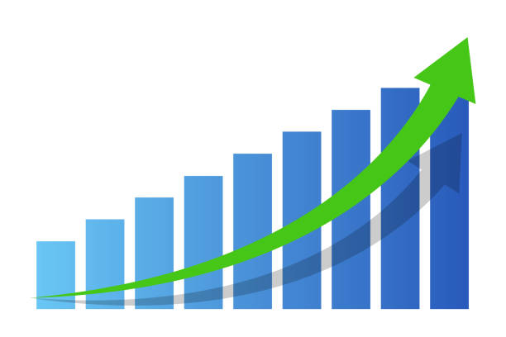
Overview Cont. - Statistics
30% of adults in the US use dating apps ¹
66% of survey respondents agreed that these apps afford them ‘a feeling of control’ over their romantic encounters ²
35% of users have spent money of dating apps. ³
$2.1 billion in 2023, expected to grow 70% each year ⁴
“by 2040, 70% of individuals will have met their significant other online” ⁵
Dating apps are the future.
Luke

Slide 5
How We Solve It
The "Goose" Action
This is the high-stakes action. clicking Goose signals definitive interest and immediately requires the user to send a short, authentic opening message.
The “Duck” Action
Acts as a simple yet creative "not interested" button. It maintains a low-friction rejection method.
Encourages Conversation
By starting the conversation before the match is even confirmed, it reduces the pressure of starting a chat from scratch, leading directly to the intended DM chain.
Higher Quality matches and Increased engagement
Brandon

Slide 6
Version 1.0 Features (In Scope)
Make an account
Add pictures and personalize profile
Home webpage
Swipe through profiles
Access profile button
Sign in/out
Matching algorithm (Duck and Goose)
Duck rejects request
Goose accepts request
Obed

Slide 7

Out of Scope Features
Messaging (This feature is a high priority. If time allows, we will build this out first)
Offering a premium service for those willing to pay the price
Any form of credit card handling
Connecting site and profiles to social media

Slide 8
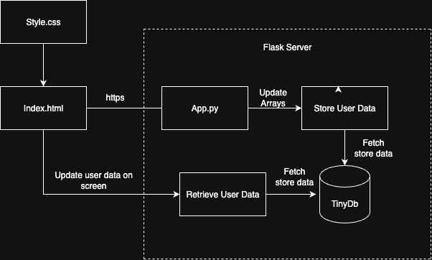
Architecture
Our app will always begin by getting login information From there the user can go edit their profile, go search through other profiles, or continue DM’s with other users.

Slide 9
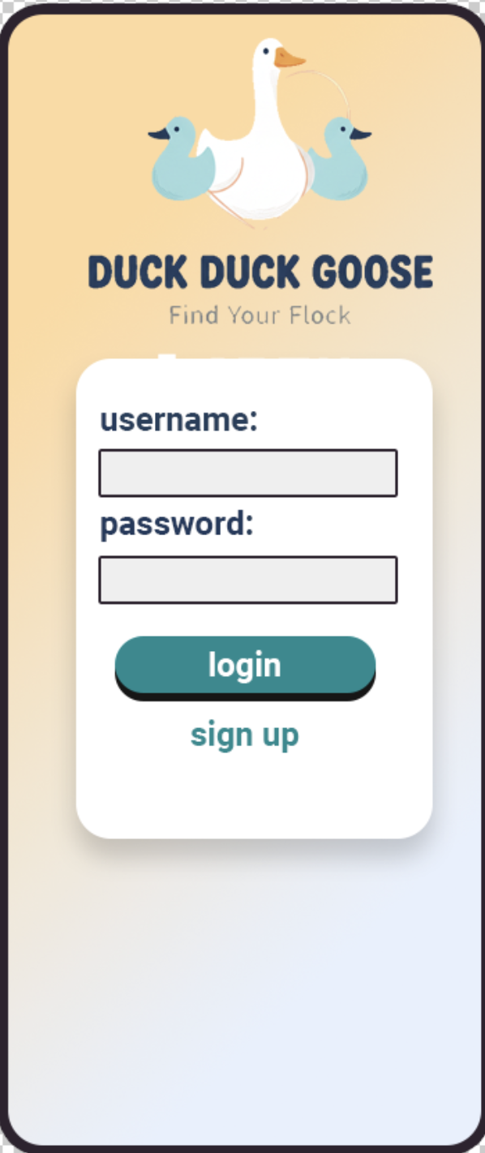
UI/UX
Our site will have a playful design and use lots of colors to achieve our goal of creating a fun environment for users to meet others.

Slide 10
Summary
DDG: A new, fresh, and fun dating app that breaks away from stale and boring designs.
Problem: Current apps have become boring and are endless swiping with superficial choices.
Solution: Fun and limited matching to encourage authentic connections.
Core features: Profile creation, algorithm-based matching, unique swipe system
Obed

Slide 11
Q&A
What would you like to know about our product?

